Slide 1


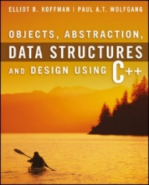
Welcome to
CS 235 Data Structures
Sequential Containers, 4.5 (13)

Slide 2
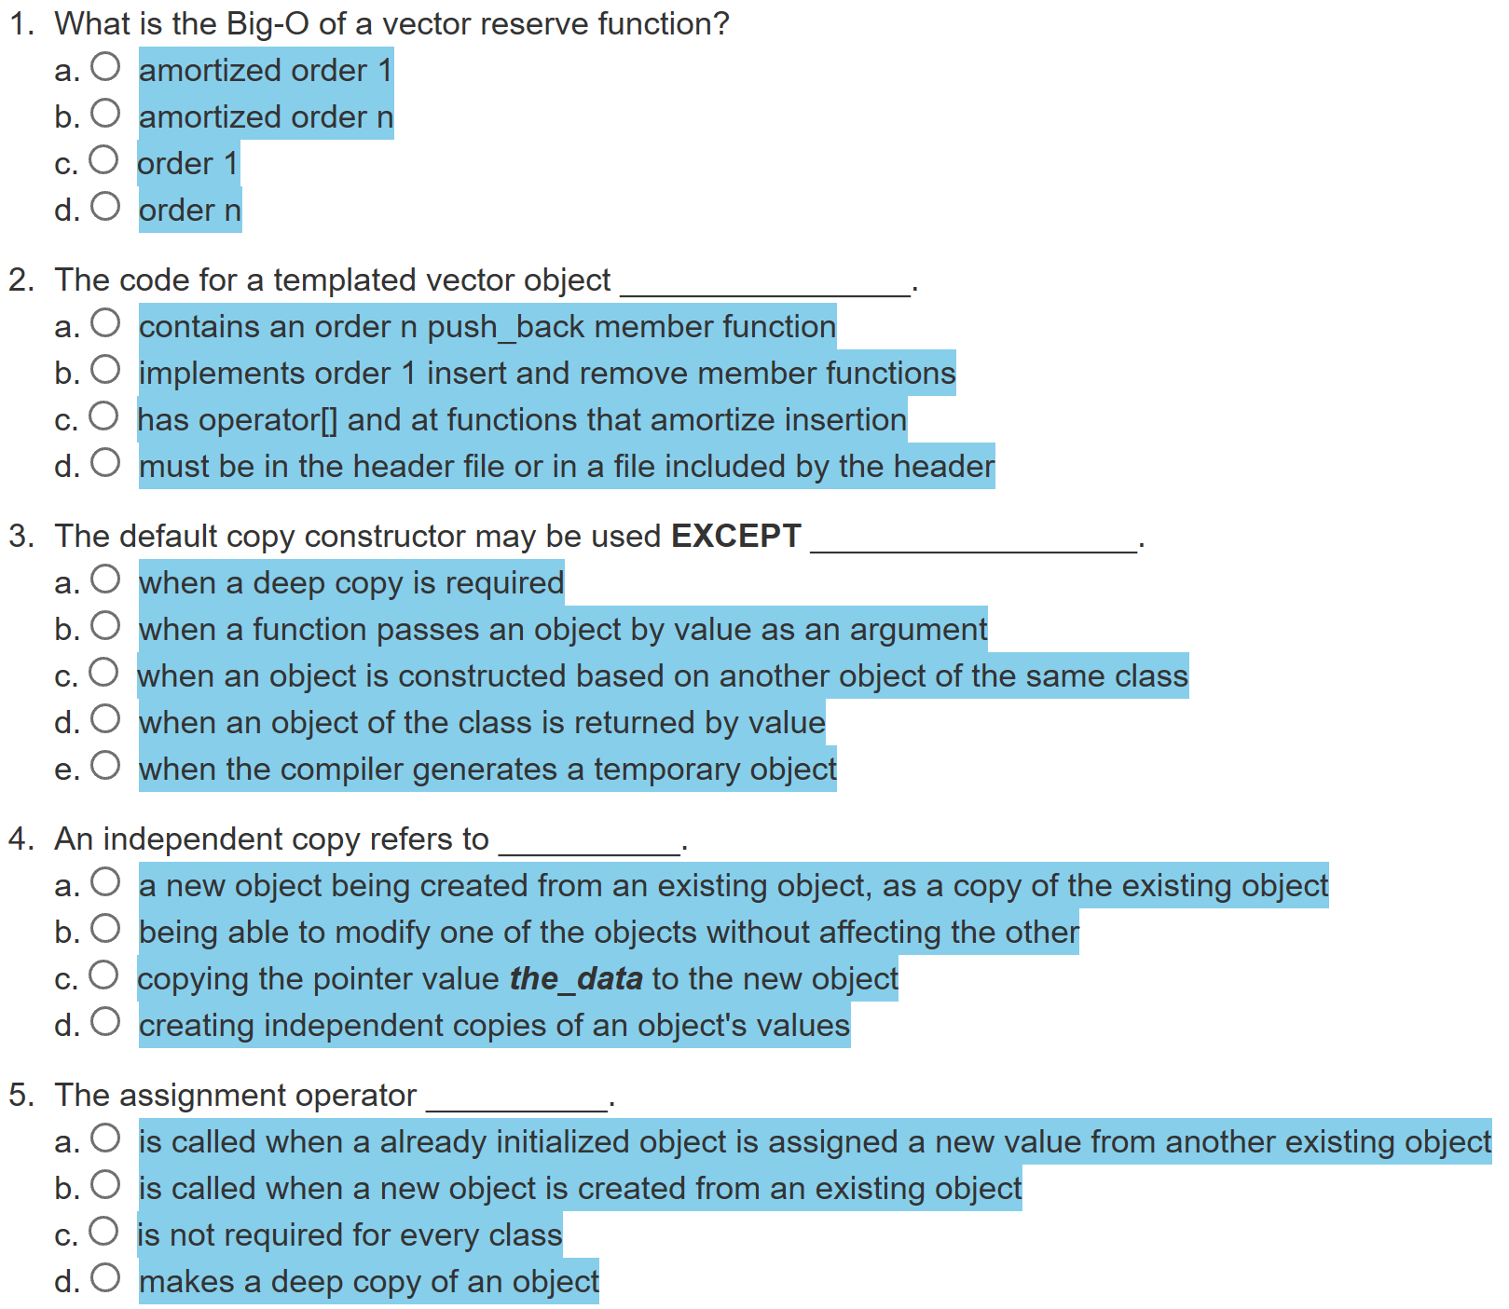
Attendance Quiz #12

Slide 3

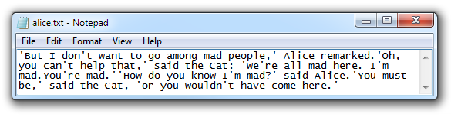
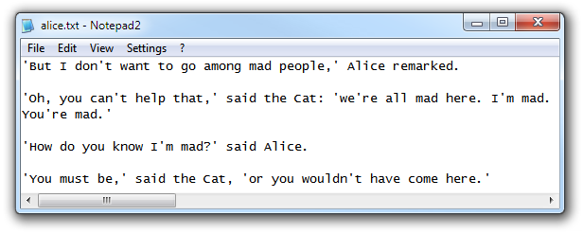
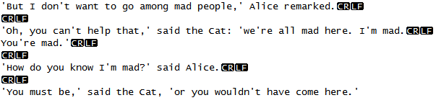
Tip #13: '\n' Confusion
Internally all applications use '\n' to indicate line termination.
But the line termination sequence is platform specific.
  Windows (DOS) uses CR and LF.
  Unix (Linux) uses LF.
  Mac (OSX) CR.
  2 additional formats:
    Unicode Line Separator (LS) and
    Unicode Paragraph Separator (PS).

Slide 4
Tip #13: Newline Confusion
The problem with platform specific line termination is
  The '\n' character is transformed into a platform specific sequence of character(s) when you write it to a file.
  The platform specific sequence is converted back to '\n' when the file is read.
The problem occurs when one writes files on one platform and reads them on another (as developing on Windows or Mac and auto-grading with g++).
  This normally isn't a problem when using only ">>" as it ignores newlines.
  But when you mix getline and ">>", you need to ignore the newlines that ">>" leaves behind.
Bad
cout << "Enter name: "; getline(cin, name); cout << "Enter city: "; cin >> city; cout << "Enter state: "; getline(cin, state);
Better
cout << "Enter name: "; getline(cin, name); cout << "Enter city: "; cin >> city; cin.ignore(); cout << "Enter state: "; getline(cin, state);
Best
cout << "Enter name: "; getline(cin, name); cout << "Enter city: "; getline(cin, city); cout << "Enter state: "; getline(cin, state);
Don't mix extraction operator with getline's!
Just use getline's!
Put a cin.ignore() after every cin >> so that there is never any rubbish in the stream.
Reads a blank line!

Slide 5
override
override is a C++11 identifier that only has meaning in the context of declaring / defining a virtual function and means that a method is an "override" of a method in a base class.
  override shows the reader of the code that "this is a virtual method, that is overriding a virtual method of the base class."
  The compiler knows that it's an override, so it can "check" that you are not altering/adding new methods that you think are overrides.
class Foo
{
public:
virtual void func1();
}
class Bar : public Foo
{
public:
void func1() override;
}
If Bar::func1() signature doesn't equal Foo::func1() signature, a compilation error will be generated because Bar::func1() does not override Foo::func1().
Note: You don't need the override identifier to do virtual overriding in C++, it simply enforces that you are doing it properly.

Slide 6
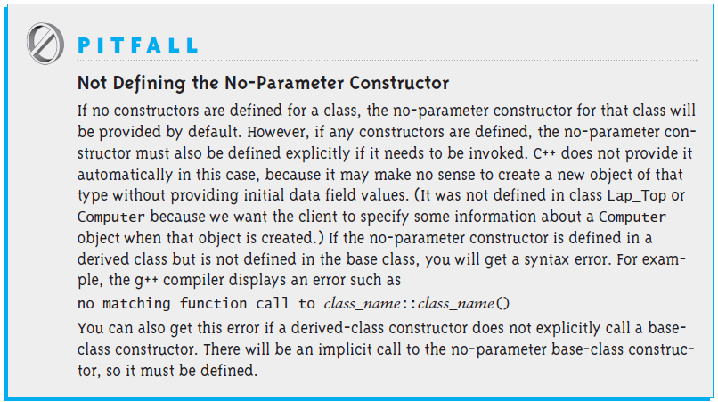
The No-Parameter Constructor
If the execution of any constructor in a derived class does not invoke a base class constructor, C++ automatically invokes the no-parameter constructor for the base class.
C++ does this to initialize the part of the object inherited from the base class before the derived class starts to initialize its part of the object.

Slide 7
C++ Interface
class Interface
{
public:
Interface(){}
virtual ~Interface(){}
virtual void myMethod() = 0; // pure virtual method
};
class MyClass : public Interface
{
private:
int myMember;
public:
MyClass(){}
~MyClass(){}
virtual void myMethod()
{
// myMethod implementation
};
};
int main(void)
{
Interface* myClass = new MyClass();
myClass->myMethod();
delete myClass;
return 0;
}
MyClass
Interface
When we create a Derived object, it contains a Base part (which is constructed first) and a Derived part (which is constructed second).
Inheritance implies an is-a relationship between two classes.
Since a Derived is-a Base, it is appropriate that Derived contain a Base part.

Slide 8
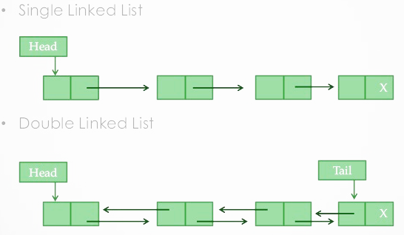
4.5 Single-Linked Lists and Double-Linked Lists
A List Node
Connecting Nodes
Inserting a Node in a List
Removing a Node
Traversing a Linked List
Double-Linked Lists
Creating a Double-Linked List Object
Circular Lists
4.5-7, pgs. 252-285

Slide 9
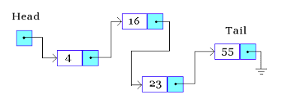
Lab 03 – Linked List

Slide 10





Lab 03 – Linked List
Linked lists are a common data structure in all object-oriented languages and will play a vital role in your activities as a programmer.
A forward linked list is a singly-linked list of node objects containing a value and a pointer to the next node.
  Only a head or first node pointer is maintained by the list.
  All list accesses begin with the head pointer.
Forward linked lists are useful containers for insertion and deletion operations in constant time.
Doubly linked lists contain three fields: two link fields (pointers to previous and next nodes in the sequence) and one data field.

Slide 11
Linked List Interface Template
//**** YOU MAY NOT MODIFY THIS DOCUMENT ****/
#ifndef LINKED_LIST_INTERFACE_H
#define LINKED_LIST_INTERFACE_H
#include <string>
template<typename T>
class LinkedListInterface
{
public:
LinkedListInterface(void) {}
virtual ~LinkedListInterface(void) {}
/** Insert Node at beginning of linked list */
virtual void push_front(const T& value) = 0;
/** Remove Node at beginning of linked list */
virtual void pop_front(void) = 0;
/** Return Node at beginning of linked list */
virtual T& front(void) = 0;
/** Return true if linked list size == 0 */
virtual bool empty(void) const = 0;
/** Remove all Nodes with value from linked list */
virtual void remove(const T& value) = 0;
/** Remove all Nodes from linked list */
virtual void clear(void) = 0;
/** Reverse Nodes in linked list */
virtual void reverse(void) = 0;
/** Return the number of nodes in the linked list */
virtual size_t size(void) const = 0;
/** Return contents of Linked List as a string */
virtual std::string toString(void) const = 0;
};
#endif // LINKED_LIST_INTERFACE_H
#ifndef LINKED_LIST_H
#define LINKED_LIST_H
using std::string;
using std::ostream;
/** Linked List */
template<typename T>
class LinkedList : public LinkedListInterface<T>
{
private:
struct Node
{
T data;
Node* next;
Node(const T& d) : data(d), next(NULL) {}
Node(const T& d, Node* n) : data(d), next(n) {}
};
Node* head;
public:
LinkedList() : head(NULL) { }
~LinkedList() { clear(); }
/** Insert Node at beginning of list */
virtual void push_front(T& value) { /*...*/ }
/** Remove Node at beginning of linked list */
virtual bool pop_front(void) { /*...*/ }
/* ... */
};
#endif // LINKED_LIST_H
LinkedListInterface.h
Must be publicly inherited by your LinkedList class.
**May not be modified**

Slide 12
Lab 03 – Linked List
COMMAND | DESCRIPTION | EXAMPLE
Clear | Delete all items in the linked list. void clear(void); | Clear OK Size 0
Empty | Output true if linked list empty, else false. bool empty(void); | Empty false Clear OK Empty true
Delete | Delete the first item in the linked list. Throw an error "Empty" if linked list is empty. void pop_front(void); | PrintList The quick brown fox jumped over the lazy dog. Delete OK PrintList quick brown fox jumped over the lazy dog. Clear OK Delete Empty!
First | Output the first item in the linked list. Throw an error "Empty" if linked list is empty. T& front(void); | PrintList The quick brown fox jumped over the lazy dog. First The Clear OK First Empty!
Insert <data>... | Insert item(s) at the head of the linked list void push_front(const T& value) ; | Insert men. good all for Insert time the is Now PrintList Now is the time for all good men.
PrintList PrintCopy | Output the contents of the linked list, space separated. Output "Empty!" if list is empty. string toString(void) const; | PrintList Now is the time for all good men. Clear OK PrintList Empty!
Remove <data> | Remove all like items from the linked list. Throw an error "Empty" if linked list is empty. void remove(const T& value); | PrintList The very brown fox jumped over the very lazy dog. Remove very PrintList The brown fox jumped over the lazy dog.
Reverse | Reverse the items in the linked list. Throw an error "Empty" if linked list is empty. void reverse(void); | PrintList fox brown quick very The Reverse OK PrintList The very quick brown fox Clear OK Reverse Empty!
Size | Return the number of Nodes in the list. size_t size(void) const; | Size 11
Copy | Make a deep copy of the current List. LinkedList<T>(const LinkedList<T>& other) LinkedList<T>& operator=(const LinkedList<T>& rhs) | Insert men. good all for Insert time the is Now Copy OK Clear OK PrintList Empty! PrintCopy Now is the time for all good men.

Slide 13
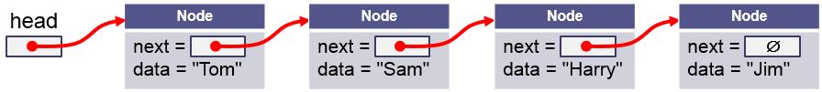
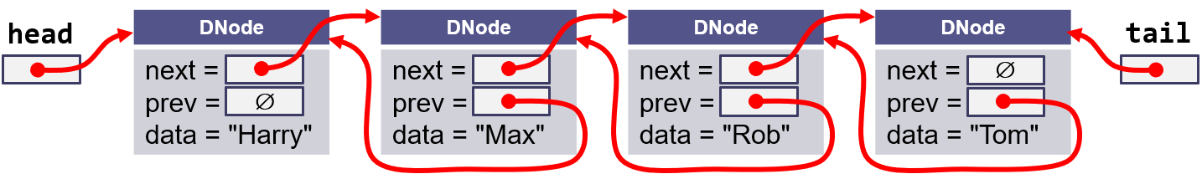
Lab 03 – Linked List (Bonus)
COMMAND | DESCRIPTION | EXAMPLE
Last | Output the list item in the linked list. Throw an error "Empty!" if linked list is empty. T& back(void); | PrintList The quick brown fox jumped over the lazy dog. Last dog. Clear OK First Empty!
Drop | Delete the last item in the linked list. Output "OK" if successful. Throw an error "Empty!" if linked list is empty. void pop_back(void); | PrintList The quick brown fox jumped over the lazy dog. Drop OK PrintList The quick brown fox jumped over the lazy Clear OK Delete Empty!
Append <data>... | Insert item(s) at the tail of the linked list void push_back(const T& value) ; | Append Now is the time for all good men. PrintList Now is the time for all good men.

Slide 14
Lab 03 – Linked List
Step 1 - Begin with a main function.
  Open for input argv[1] and for output argv[2].
  Add code to read and output input file.
  Parse input commands and output corresponding messages.
Step 2 - Design and implement a LinkedList template class.
  Create a LinkedList template class that inherits from LinkedListInterface class. Since LinkedListInterface is an abstract class, stub out all virtual functions so that there are no compiler errors. Include both .h files in your main file.
  Implement one function at a time and then test it before moving on to the next one. Try implementing more basic functions first, like toString and Insert.
  Create your own test case files to aid in your incremental testing.
Step 3 - If desired, implement the bonus double-linked list functions and commands.
Step 4 - When you've completed the incremental testing, test your program with the provided test cases.

Slide 15
Lab 03 – Linked List
Points | Requirement
10 | Basic linked list commands Insert, Clear, and PrintList commands are correctly implemented. (lab03_in_01.txt).
5 | Linked list Empty and Size commands are correctly implemented. (lab03_in_02.txt).
10 | Linked list Delete, First, and Remove commands are correctly implemented. (lab03_in_03.txt).
10 | Linked list Reverse command is correctly implemented. (lab03_in_04.txt).
10 | An error is thrown ("Empty!") when front(), pop_front(), or reverse() linked list methods are called with empty lists. A try-block in main catches and reports the error. Processing of input commands continues. (lab03_in_05.txt).
5 | Linked list Copy command is correctly implemented. (lab03_in_06.txt).
+10 Extra Credit | Double-linked list Last, Append, and Drop commands are correctly implemented. All singly-linked commands described above work properly. (lab03_in_07.txt).
-10 | Memory leaks, g++ compiler warnings, array out-of-bounds detected, or execution interactions.
 | Peer Review
2 | LinkedList is a template class and is derived from the pure abstract template class LinkedListInterface.
2 | A try-block in main catches and reports errors such as accesses to empty lists.
2 | All derived class objects have a public insertion (<<) operator.
2 | A user define deep assignment operator is called by the COPY command.

Slide 16


Be Safe

